Slide 1
BREAST CANCER PREDICTION
REVIEW - 1
By
19BCE1532 - Hima Rani Mathews
19BCE1588 - Kamalika Gunasekaran

Slide 2
INTRODUCTION
Breast cancer (BC) is one of the most common cancers among women worldwide, representing the majority of new cancer cases and cancer-related deaths according to global statistics, making it a significant public health problem in today’s society.
The early diagnosis of BC can improve the prognosis and chance of survival significantly, as it can promote timely clinical treatment to patients. Thus, the correct diagnosis of BC and classification of patients into malignant or benign groups is the subject of much research. Because of its unique advantages in critical features detection from complex BC datasets, machine learning (ML) is widely recognized as the methodology of choice in BC pattern classification and forecast modelling. Classification and data mining methods are an effective way to classify data. Especially in medical field, where those methods are widely used in diagnosis and analysis to make decisions.

Slide 3
OBJECTIVES
This analysis aims to observe which features are most helpful in predicting malignant or benign cancer and to see general trends that may aid us in model selection and hyper-parameter selection. The goal is to classify whether the breast cancer is benign or malignant. To achieve this we will be using machine learning classification methods to fit a function that can predict the discrete class of new input.
Machine learning techniques can bring a large contribute on the process of prediction and early diagnosis of breast cancer, became a research hotspot and has been proved as a strong technique. In this study, we applied five machine learning algorithms: Random Forest, Logistic Regression, Naive Bayes classifier, XGBoost and K-Nearest Neighbours (KNN) on the Breast Cancer Wisconsin Diagnostic dataset, after obtaining the results, a performance evaluation and comparison is carried out between these different classifiers.

Slide 4
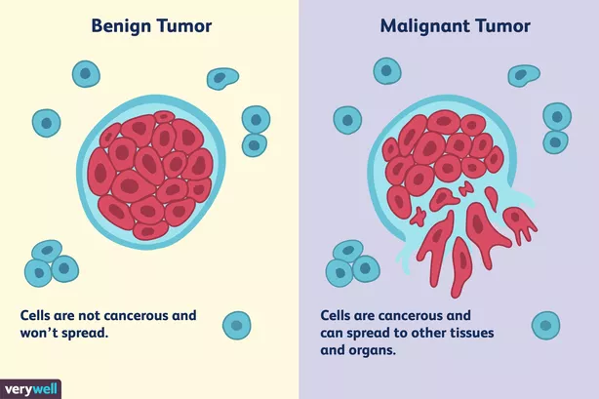

Slide 5
DATASET
Dataset Used : Breast Cancer Wisconsin (Diagnostic) Data Set by UCI Machine Learning. It contains 568 rows and 33 columns.
The dataset is taken from Kaggle repository https://www.kaggle.com/uciml/breast-cancer-wisconsin-data
Attribute Information:
ID number
Diagnosis (M = malignant, B = benign) 3–32)
Ten real-valued features are computed for each cell nucleus:
radius (mean of distances from center to points on the perimeter)
texture (standard deviation of gray-scale values)
perimeter

Slide 6
6. smoothness (local variation in radius lengths)
7. compactness (perimeter² / area — 1.0)
8. concavity (severity of concave portions of the contour)
9. concave points (number of concave portions of the contour)
10. Area
11. symmetry
12. fractal dimension (“coastline approximation” — 1)
The mean, standard error and “worst” or largest (mean of the three largest values) of these features were computed for each image, resulting in 30 features. For instance, field 3 is Mean Radius, field 13 is Radius SE, field 23 is Worst Radius.

Slide 7
METHODOLOGY
High-Level Data Analysis : The dataset characteristics - dimension, missing values, data types were observed.
Data Exploration : Individual variables were analysed for patterns, and hidden correlations.
Modeling : Logistic Regression, Random Forest, Naive Bayes Classifier, KNN Model and XGBoost will be applied, and fit performance will be evaluated using metrics like Accuracy, Precision, Recall.
Conclusion : Best model will be chosen based on the performance and evaluation metrics.

Slide 8
MODELS
LOGISTIC REGRESSION : It is used in statistical software to understand the relationship between the dependent variable and one or more independent variables by estimating probabilities using a logistic regression equation. Logistic Regression is used when the dependent variable(target) is categorical.
KNN MODEL : This algorithm is a simple, easy-to-implement supervised machine learning algorithm that can be used to solve both classification and regression problems. It assumes the similarity between the new case/data and available cases and put the new case into the category that is most similar to the available categories
NAIVE BAYES MODEL : It is a classification technique based on Bayes' Theorem with

Slide 9
an assumption of independence among predictors. It is a probabilistic classifier, which means it predicts on the basis of the probability of an object.
RANDOM FOREST MODEL : Random forest is a Supervised Machine Learning Algorithm that is used widely in Classification and Regression problems. It builds decision trees on different samples and takes their majority vote for classification and average in case of regression.
XGBOOST : XGBoost is a decision-tree-based ensemble Machine Learning algorithm that uses a gradient boosting framework. Weights play an important role in XGBoost. Weights are assigned to all the independent variables which are then fed into the decision tree which predicts results. The weight of variables predicted wrong by the tree is increased and these variables are then fed to the second decision tree. These individual classifiers/predictors then ensemble to give a strong and more precise model.

Slide 10
THANK YOU

